Slide 1

HanDIYcraft
PROGRESS REPORT I
By
Nahathai Kaewtatib 542115018
Pimchanok Sripraphan 542115043

Slide 2
Agenda
Introduction
Progress report 1 work items
Software demo
Mistakes and problems
Progress 2 plan

Slide 3


Introduction

Slide 4
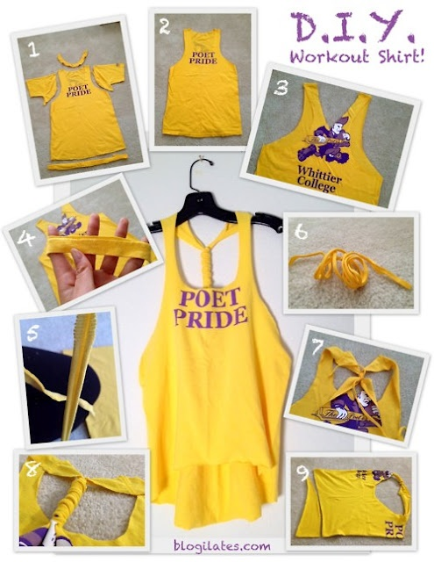

Introduction
DO
It
Yourself

Slide 5



Limits
Operates on
requires
No security
Android os
Internet
connection
Inappropriate
information

Slide 6






Users
send messages
Explore shops
Explore tutorials
manage tutorials
Share to facebook
comment
Search blogger
send messages
manage
shops
visitor
blogger
shopkeeper

Slide 7






Features
Authorization
tutorial
shop
map
communication
notification

Slide 8
Progress Report 1
Work items

Slide 9
Work items
Project
plan
SRS software requirement specification]
SDD [software design document]
Test plan
Traceability record
Test record

Slide 10
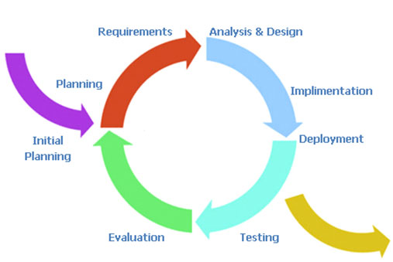
Project Plan

Slide 11
Project Plan
7
7
SRS software requirement specification]
Project
plan
15
40
SDD [software design document]
implementation
10
5
Traceability record
Test plan
Test record

Slide 12

Repository

Slide 13

SRS Document
Use Case
User Requirement Specification (URS) and Description
Activity Diagram
System Requirement Specification (SRS)

Slide 14


Requirement Analysis
feature
Use case
urs
srs
Activity
diagram
Urs
description

Slide 15

Use case

Slide 16

Use case

Slide 17
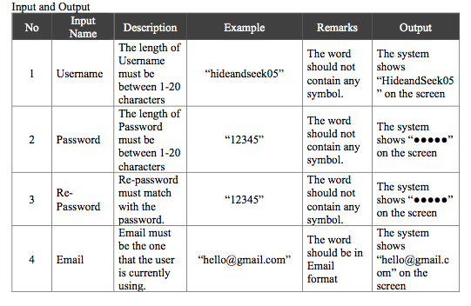
URS & URS Description
W-URS-01: The user registers as a blogger.

Slide 18
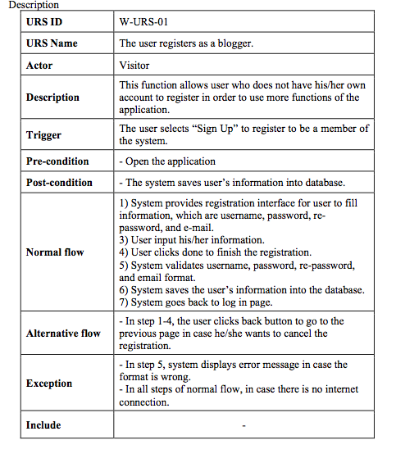
W-urs-01 description

Slide 19
Activity diagram
W-AD-01

Slide 20
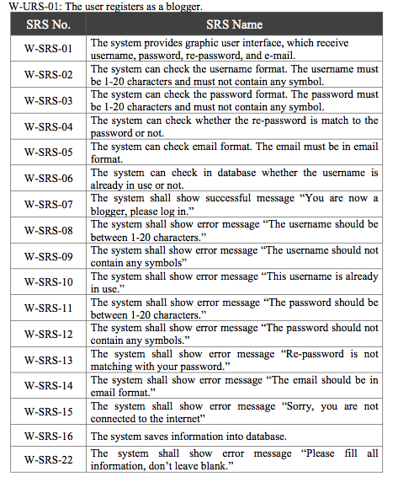
SRS

Slide 21
Software Design
System Architecture
Class Diagram and Description
Sequence Diagram
Database Design
User Interface Design
Traceability Record

Slide 22





Architecture
Explore
Visitors
HanDIYcraft
Google Maps API
Manage
Bloggers
Shopkeepers
Facebook
request
response
JSON
HanDIYcraft
request
response
My SQL
JSON
Server

Slide 23
Class
diagram

Slide 24
Class Diagram Description

Slide 25
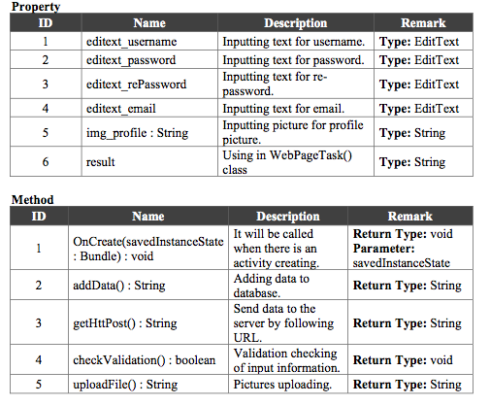
Class Diagram Description

Slide 26

Sequence diagram

Slide 27

Sequence diagram

Slide 28
Database design

Slide 29
User interface design

Slide 30
User interface design

Slide 31
Software Construction
SRS [software requirement specification]
SDD [software design document]
HanDIYcraft
HanDIYcraft

Slide 32

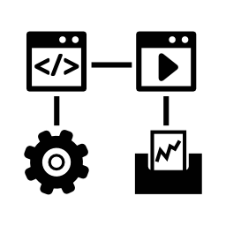

Software Testing
Test Plan
Unit Testing
System Testing
Test Record
Input
Output
Input
Output

Slide 33
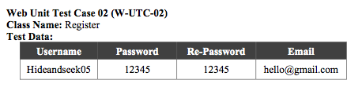
Unit test case

Slide 34
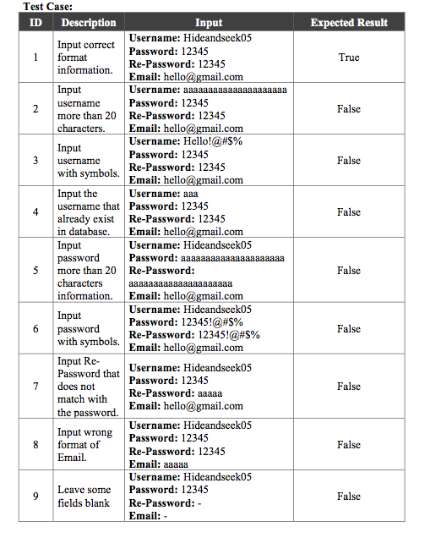
unit
Test Case

Slide 35
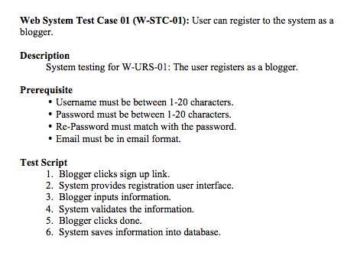
System test case

Slide 36
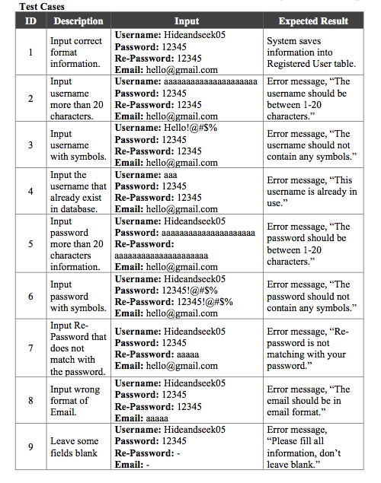
system
Test Case

Slide 37
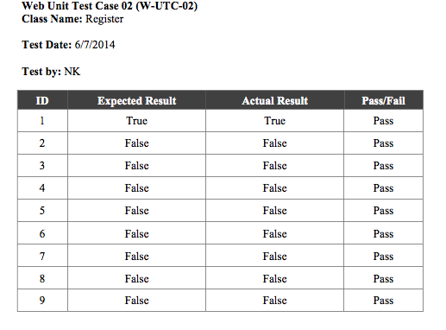
unit Test record

Slide 38
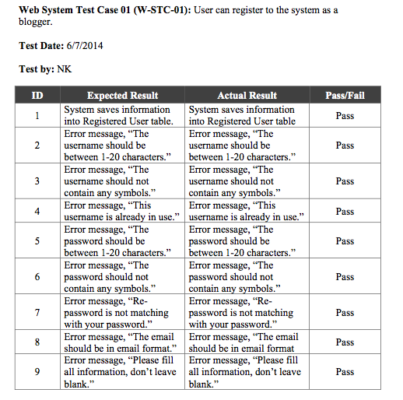
System Test record

Slide 39
Software
Demo

Slide 40
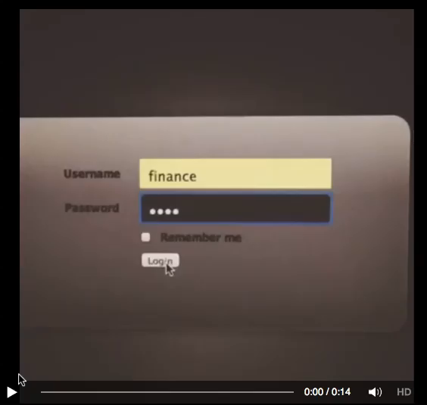
Software Demo

Slide 41
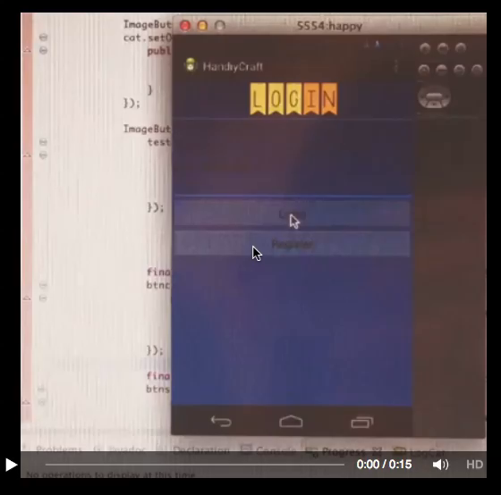
Software Demo

Slide 42
Mistakes and
Problems

Slide 43


Mistakes
Version control

Slide 44

Mistakes
Video still can’t be shown

Slide 45


Mistakes
Less
talking
More
fixing

Slide 46
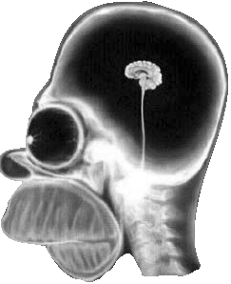

Problems
Less technical knowledge

Slide 47
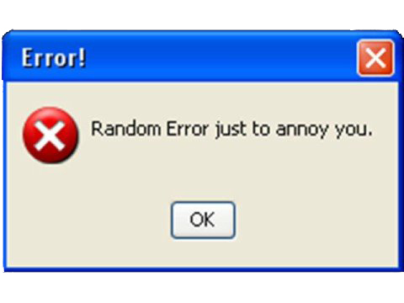
Problems
computer crash

Slide 48
Progress 2
Plan

Slide 49
Software
Version 0.2
Feature 3
Shop
management
(Mobile)
Feature 5
Communication
management
(Mobile, Web)
Feature 4
Map management
(Mobile)

Slide 50

Document
Version 2.0
Project Plan document
SRS document
SDD document
Test Plan document
Test Record document
Traceability Record document

Slide 51
Q&A

